Slide 1

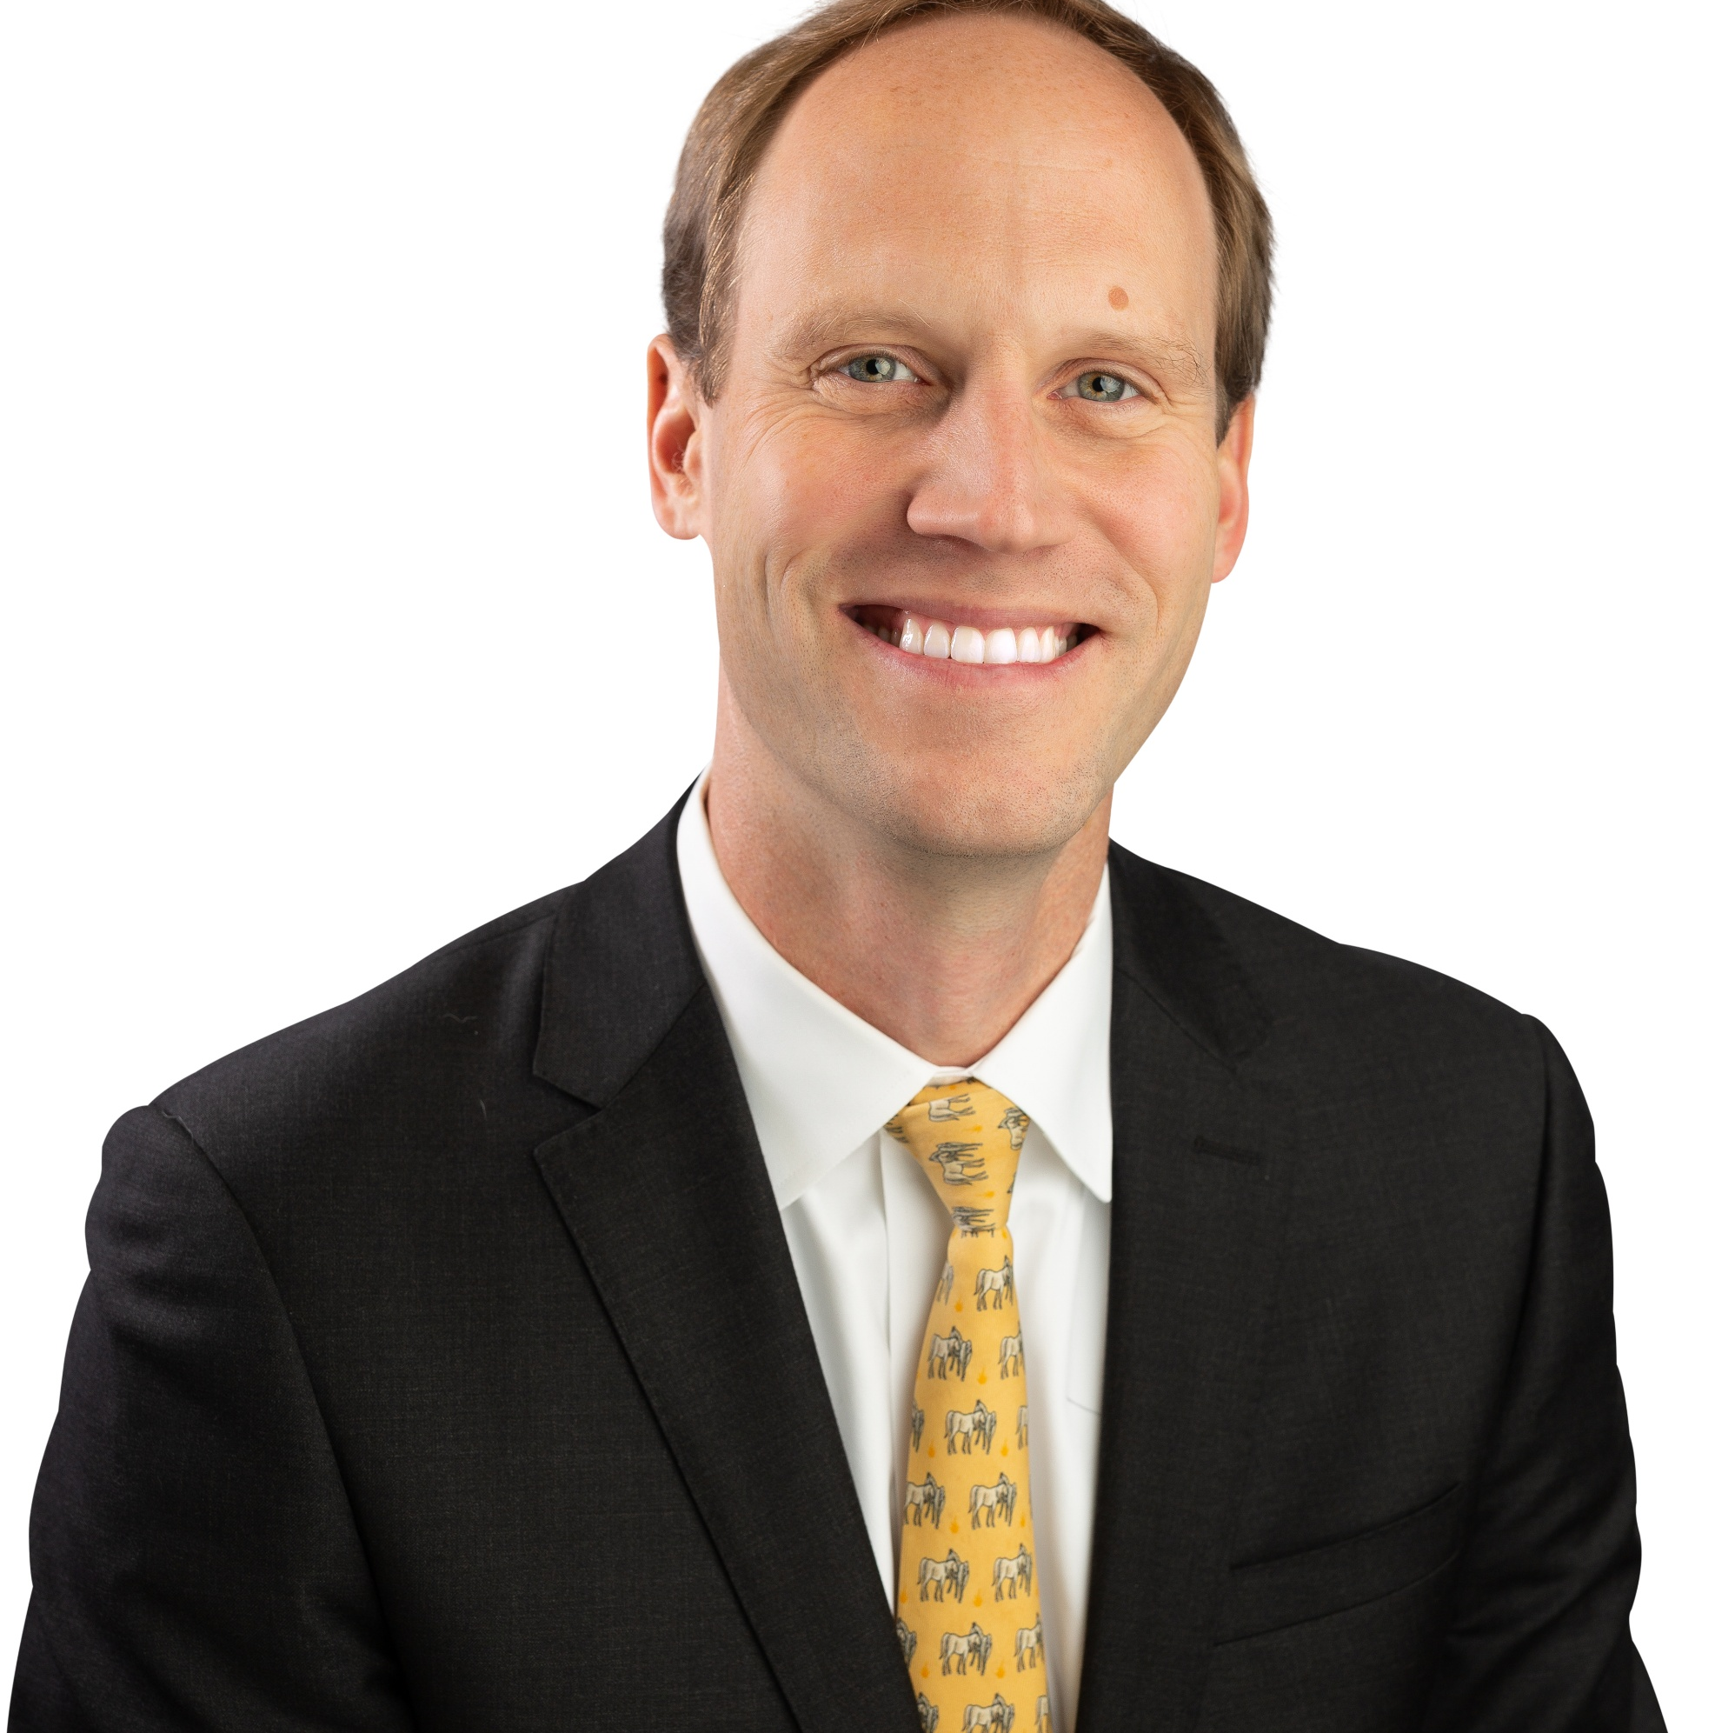
PROPRIETARY AND CONFIDENTIAL
MEETING WITH YOU TODAY
00
Management Profile
Tom is responsible for leading new client acquisition, market expansion, and client engagement efforts to drive growth and build long-term relationships. With more than 17 years of experience in product, sales, operations, and client management,
Tom has worked extensively with payers, providers, and risk-bearing organizations to bring innovative products and services to market that deliver measurable results. Tom has expertise in translating market needs into actionable product and growth strategies, bridging gaps between business development, product strategy, IT, and operational execution.
Over the past several years, Nikki has focused on:
• Revenue and Product Growth
• New Product Development
• Building Startups
• B2B and B2C Growth Strategy
• Operational Efficiency
Tom Sherrard
EVP, Sale & Market Development
615-496-0442
tom@healthrate.io

Slide 2
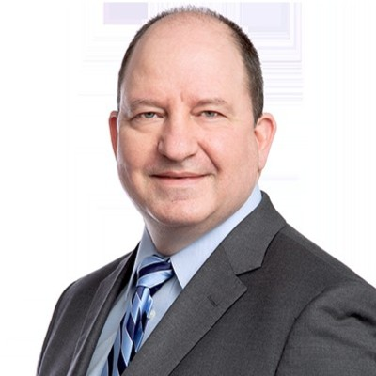
PROPRIETARY AND CONFIDENTIAL
MEETING WITH YOU TODAY
00
Management Profile
Jeff serves as the CTO anc co-founder of HealthRate and has over 25 years of experience across healthcare with a focus on IT strategy, platform implementation, architecture, software development..
Prior to HealthRate, Jeff focused on IT strategy and transformation in the management consulting industry. He has led strategy, platform development and delivery across the United States as well as Mexico, Brazil, New Zealand, Italy, Singapore and the UK.
Over the past several years, Jeff has focused on:
• Healthcare provider technology
• Product Development and Deployment
• Cloud implementation, migration and operations
• Electronic Health Records (EHR) Implementation
• Customer, Member, and Patient Portals and Customer Relationship Management
• Data Center Strategy and Builds
• Business Continuity and Disaster Recovery
Jeff Sage
Chief Product Officer
303.877.9067
jeff@healthrate.io

Slide 3
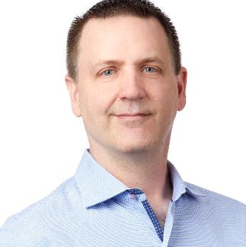
PROPRIETARY AND CONFIDENTIAL
MEETING WITH YOU TODAY
00
Management Profile
Tim is the Founder and CEO of HealthRate and has over 30 years of experience across healthcare with a focus on risk management, analytics, reimbursement strategies, and software development.
Prior to starting HealthRate, Tim successfully led the formation and operations of several public and private companies, worked as a strategic advisor to prominent organizations across industries and served on multiple governance boards. He has extensive experience in operations, product development, risk management, and information technology
Over the past several years, Tim has focused on:
• Healthcare Insurance and reinsurance
• Product Development
• Payment Integrity
• Revenue Cycle Optimization
• Analytics and Business Intelligence
• Artificial Intelligence and Machine Learning
• Customer, Member, and Patient Insight and Customer Relationship Management
• Strategic Information Systems Assessment and Planning
• Operational Assessment and Performance Improvement
TIM MICHAELS
Chief Executive Officer
612.747.5927
tim@healthrate.io

